Slide 1
Introduction to R
Part 2

Slide 2
Topics covered
What is programming?
What is R?
Finding your way around RStudio
Basic operations and assignment
Functions
Comments
Extensions and getting help

Slide 3
What is programming?

Slide 4
What is programming?
Computers cannot solve problems. They only help solve well-posed problems
Programming is the process of commanding the computer to solve problems. It is an elaborate process.
Involves:
Specification: Stating precisely the nature of the problem that needs to be solved
Formulation: Designing and implementing an appropriate solution
Evaluation: Check if the solution is appropriate. Are there bugs?

Slide 5
Specification, formulation and evaluation (simple example)
Specification: I need a way to cross from A to B, and I think a bridge is the best solution (the mayor)
Formulation: We designed and built a bridge (the architect and engineer)
Evaluation: Is the bridge truly linking between A and B? Is the bridge stable? Is the bridge truly the best solution? (auditor and reviewer)
This process is not so different from carrying out a scientific project
Notes:
Note that specification of a problem may also involve mirroring some innate bias on how best to solve the problem. You will not know this until it comes to evaluation

Slide 6
Specification exemplifies the problem
Examples:
Does gene A cause disease X?
I need a smart program that can select the best statistical test given my data
I need to compare two sequences to find out how similar they are
The problem must be stated as specific as possible such that an appropriate
Notes:
Ask students --- what are examples of a bad question?
e.g. I need to compare to sequences. Is this a good statement? How do you want to compare the two sequences? What is the specific outcome you want?

Slide 7
Formulation is achieved via algorithms
An algorithm is an ordered series of steps for problem solving
It should be exact and unambiguous
It can be expressed by a programming language (where it becomes a program)

Slide 8
Evaluation After we write the program and run the analysis, we should not stop there. We must always ask ourselves:
Is the solution good enough?
Is the solution correct?
Is the solution efficient?
Do we suspect bugs in the code?

Slide 9
Evaluation
Not all proposed solutions solve the problem
An imperfect solution may lead to the correct outcome but takes a long time
A wrong solution creates errors

Slide 10
What is R?

Slide 11
Application Languages
Good for connecting to databases
Interfacing between user and database
Extremely fast development
Programmers are freed from the low-level details (e.g. memory allocation) that you have to contend with when working with architectural and system level languages.
Scripting languages (that don’t need to be compiled,) adds to the ease of use and speed of development
E.g. Python, PHP, PERL

Slide 12
Statistical programming
Not considered serious programming languages
Combines ease of computation with graphical output
Also considered scripting language as they also do not need to be compiled
E.g. R, Mathematica

Slide 13
R is a statistical programming language
R compiles and runs on Windows, Mac OS X, and numerous UNIX platforms (such as Linux).
R is a “statistical programming” language providing an optimized environment and support for statistical computation and graphics
It also allows integration with compiled code written in C, C++, Fortran, Java, etc., for computationally intensive tasks or for leveraging tools provided for other languages.

Slide 14
R advantages
R is a highly customizable yet fully functional programming language
R is powerful, expandable and is supported by an active data science/math/stats community
R is free!
Amongst languages, R has the one of the most powerful graphics producing capabilities

Slide 15
R disadvantages
R is difficult to learn due to complex syntax
R has many different data structures
R has relatively weak text parsing ability
Lax organization --- can breed bad coding habits in beginners

Slide 16
R in the biosciences
They allow scientists to compare a human and a Neanderthal genome (using Bioconductor); to model population growth (IPMpack); predict equity prices (quantmod); and visualize the results in polished graphics (ggplot2) in a few lines of code.
Experts can use R to write up manuscripts, embedding raw code in them to be run by the reader (knitr).
Nearly 1 in 100 scholarly articles indexed in Elsevier’s Scopus database last year cites R or one of its packages — and in agricultural and environmental sciences, the share is even higher

Slide 17
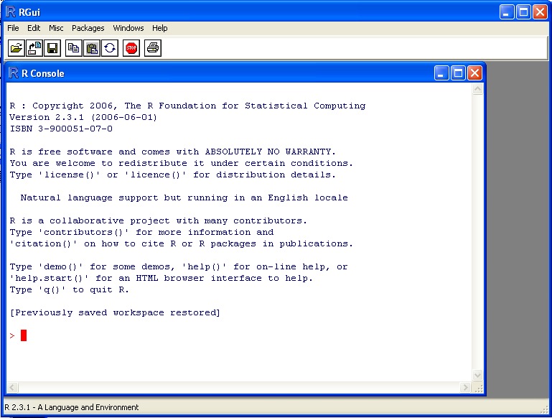
The GUI and command prompt
When running R, the first thing to observe is the Graphical User interface (GUI)
At the prompt (>), you can enter numbers and perform calculations e.g. > 1 + 3
You also enter commands here although this is not a good place to develop code
We will use an Integrated Development Environment (IDE) instead

Slide 18
Finding your way around RStudio

Slide 19
What is RStudio?
RStudio is not R.
It is a separate open-source project that brings many powerful coding tools together into an intuitive, easy-to-learn interface. Rstudio is an Integrated Development Environment (IDE).
RStudio runs on all major platforms (Windows, Mac, Linux) and through a web browser (using the server installation).
Download and install a copy of Rstudio here (http://www.rstudio.com/)
Notes:
For applications running under Mac OS X, start by clicking on its icon in the Applications folder.
For Windows users, the installation process leaves a menu item.
For Linux users, the command rstudio will open the window. It may also be installed with a menu item, as is done with Ubuntu, where it appears under Programming.

Slide 20
Why use an IDE?
An IDE facilitates code development
It includes:
A console for issuing commands.
Source-code editor preferably with a rich set of keyboard shortcuts
Other perks include automatic source-code formatting, assistance with parentheses, keyword highlighting, interfaces for compiling or running of software, project-management features, debugging assistance and integration with report-writing tools
RStudio can do all these things

Slide 21
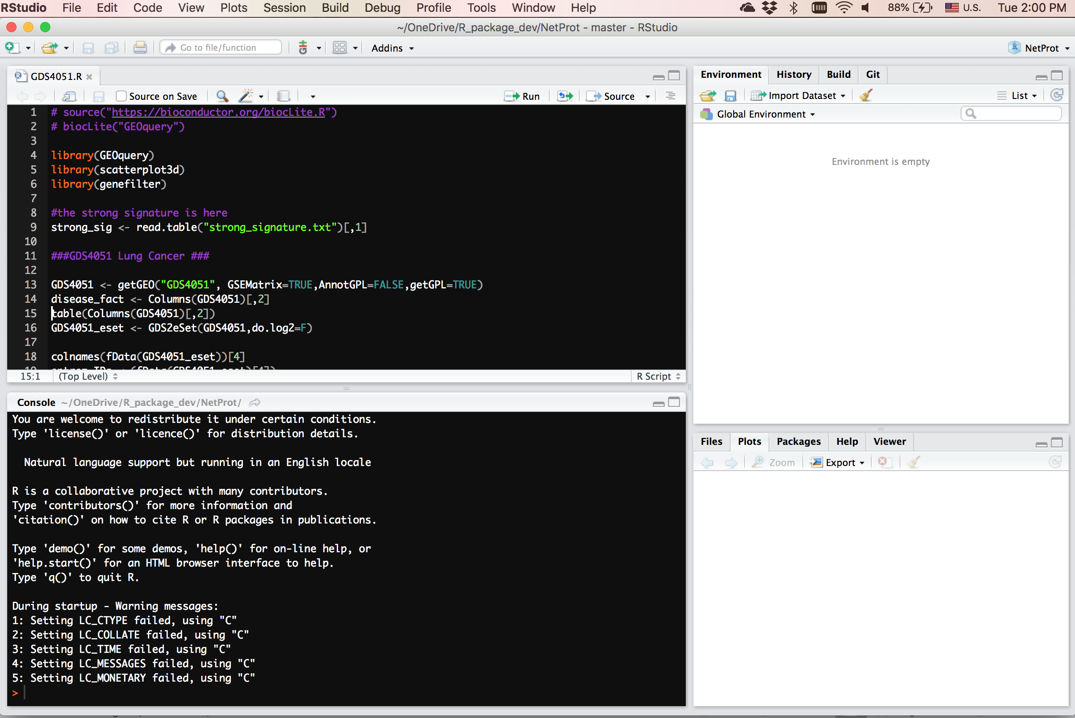
Layout of R Studio
The main components of RStudio are all nicely integrated into a four-panel layout that includes a console for interactive R sessions, a tabbed source-code editor to organize a project’s files, panels with notebooks to organize less central components, and a list of data objects already loaded into memory
a tabbed source-code editor
list of data objects already loaded into memory
console for interactive R sessions
Notebook panel
Notes:
The source-code editor is feature-rich and integrated with the built-in console.
The console and source-code editor are tightly linked to R’s internal help system through tab completion and the help page viewer component.
Setting up different projects is a snap, and switching between them is even easier.
RStudio provides many convenient and easy-to-use administrative tools for man- aging packages, the workspace, files, and more.

Slide 22
Entering commands via the console
console for interactive R sessions
Notes:
The simplest use of R involves typing one or more commands at the prompt (usually a > symbol) and then pressing the enter key.
Commands can be combined on one line if separated by a semicolon and can extend over multiple lines. Once entered, the command is sent back to the R interpreter.
If the commands are complete and there are no errors, R returns the output from the call on the console unless specified otherwise.
We will look at some ways now how we may enter some basic operations and commands on the command prompt.

Slide 23
Basic operations and assignment

Slide 24
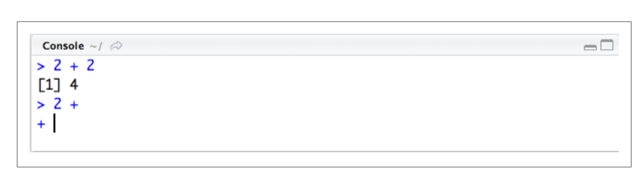
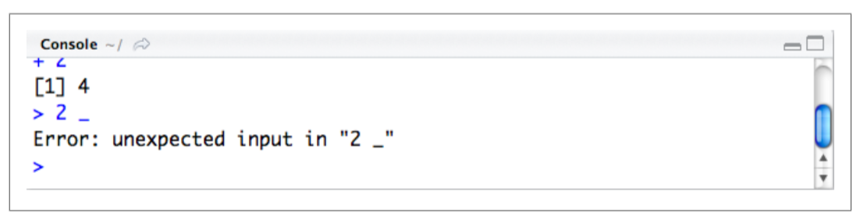
Operations on the console
Notes:
The picture on top shows how RStudio responds to the command to add 2 and 2.
The commands appear in blue and the output in black. These colors can be customized (as is the background).
Not all commands return outputs. In the RStudio console, the input and output may be perused by the user and copy-and-pasted, but may not be directly edited.
When a command is incomplete, R’s parser will recognize this and allow the user to type onto the following line. In this case, the prompt turns to the continuation prompt (typically a +). Multiline commands can be entered in this manner (even without the use of semi-colons).
When a command containing an error is issued, RStudio returns the appropriate error message generated by R. For experienced programmers, these error messages are usually very informative.

Slide 25
Assignment
To assign a value to a variable
Type as “<-” which means ←
Can also use the equals sign “=“
e.g. x =1 or x <-1 means the same thing in R
However, seasoned R programmers prefer to use <-
Notes:
Many commands involve assignment to a variable. R has two commonly used options for assignment: = and ← (the latter is preferred by most longtime R users).

Slide 26
Basic arithmetic operations and value assignment
Operator | Meaning
+ | Plus/ Summation
- | Minus/ Subtraction
* | Times/ Multiply
/ | Divide (where a/b means a divide over b)
^ | Power of where a^b means a to the power of b or simply a^{b}
Arithmetic Operations:
+, -, *, /, ^ are the standard arithmetic operators

Slide 27
Logical operations
Operator | Meaning
> | Greater than
>= | Greater than or equal to
== | Equals to
!= | Not equals to

Slide 28
Putting it together
# An example of computing the mean with variables
mydata$sum <- mydata$x1 + mydata$x2 mydata$mean <- (mydata$x1 + mydata$x2)/2

Slide 29
Functions

Slide 30
What is a function?
A function is a well-defined autonomous piece of code
It can contain both data and methods
Conceptually related to OOP. But it differs in the sense that functions are not initiated from a constructor class (no inheritance)
R has many built in functions that can conveniently called upon

Slide 31
Using R Functions
R functions are invoked by its name, then followed by the parenthesis, and including zero or more arguments
Using the combine function c() to merge three numeric values into a vector e.g. c(1,2,3)
Or using the sum() function as sum(1,2,3) or sum(c(1,2,3))

Slide 32
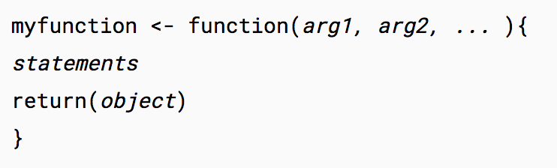
Creating your own function
There are many functions in R, and for most purposes, are sufficient to meet needs
There are occasions however, when you have to create your own function
This can be expressed in the form:

Slide 33
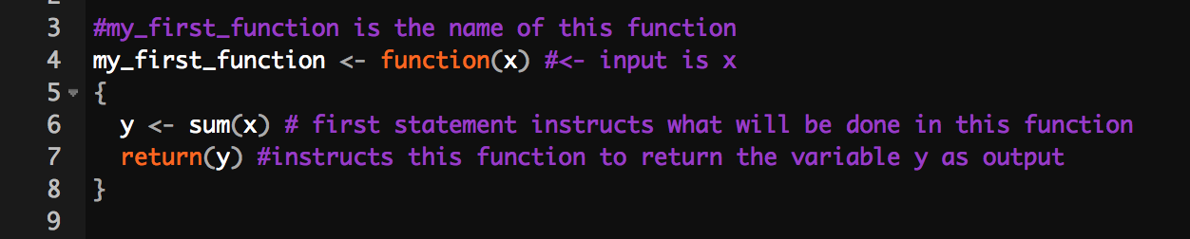
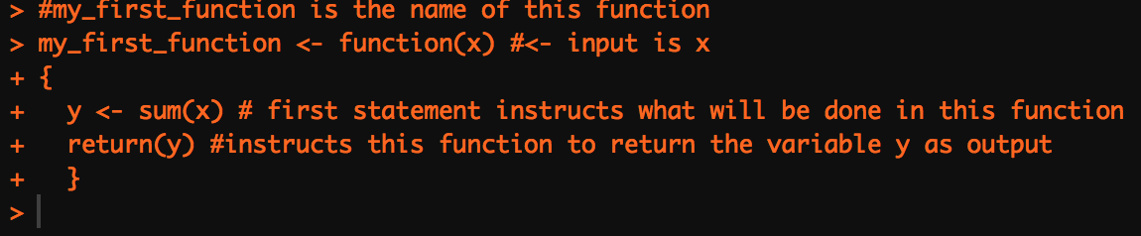
Creating your own function
Using the function command to create a new function “my_first_function()”.
Console shows no error

Slide 34
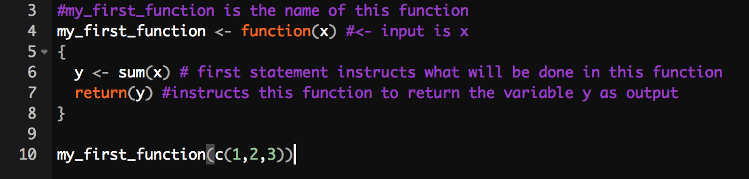
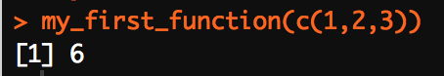
Creating your own function
This function as you can see, does not actually do much. It is basically calling the sum() function within itself and returning the output from sum().
However, the ability to combine and call functions within functions, can be very powerful and neater in terms of organization.
It is also a useful option when writing complex code requiring repetitive components.

Slide 35
Comments

Slide 36
Comments
a comment is a programmer-readable explanation or annotation in the source code of a computer program.
They are added for the purpose of making the source code easier for humans to understand
Comments are ignored by compilers and interpreters.

Slide 37
Comments
Code
Console
All text after the pound sign "#" within the same line is considered a comment.
A comment will not be run as part of the program. It tells you what each part of the program does. Appropriate use of # is really important for documentation and forms part of good coding practice.
Also note that if you removed the # in the code above, errors will occur!

Slide 38
Extensions and getting help

Slide 39
Extensions
R comes with many useful prebuilt functions but sometimes you need more!
You do not always have to write your own functions each time something is not in the prebuilt library
You simply download and install!
To do this, you simply use the install.packages() function

Slide 40
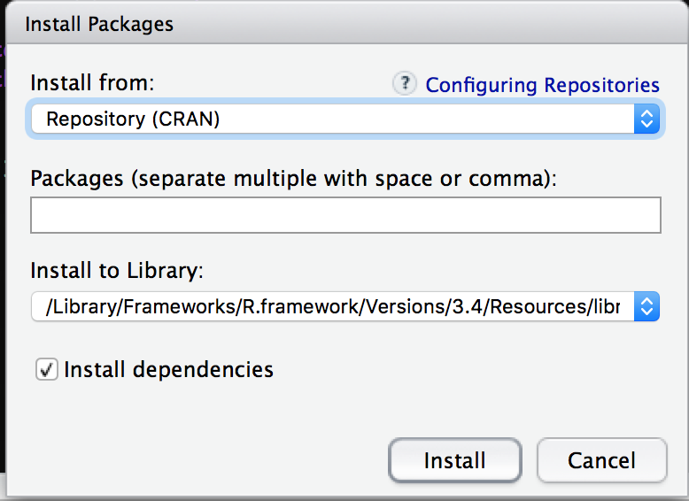
Extensions
Another way is to use the toolbar where under “Tools”, go to “Install Packages…”
Notes:
You will see several options. The “install from” drop down tab will provide choices on whether you want to scan for packages already on the online repository CRAN, or if you want to install a locally downloaded package.
Multiple packages can also be installed simultaneously.
Some packages require other packages to work. They are thus dependent on these. Clicking install dependencies will autoinstall these other packages without you specifying them explicitly.

Slide 41
CRAN
R is extensible via packages to supplement the base distribution
This is supported via a worldwide repository system, the Comprehensive R Archive Network (CRAN)—http://cran.r-project.org
As of 2011, there were more than 3,000 such packages hosted on CRAN

Slide 42
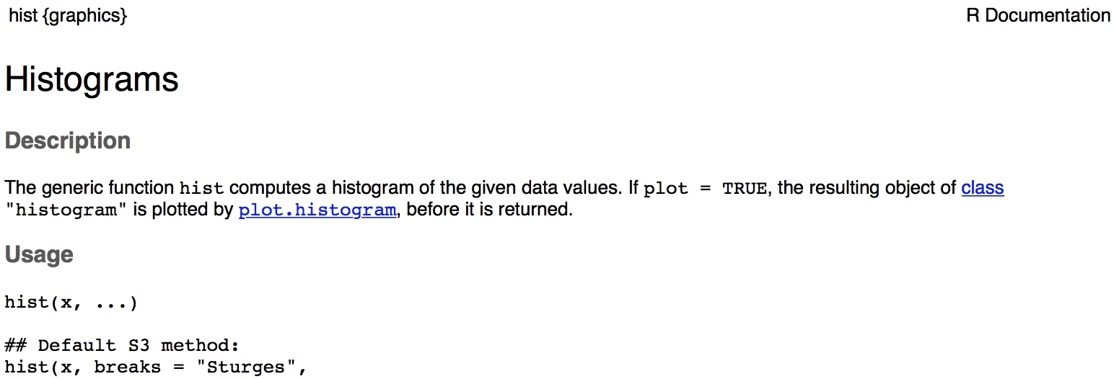
Getting help
How to use help in R?
R has a very good help system built in.
If you know which function you want help with simply use ?<function name>
For example, typing ?hist will produce the following in the notebook panel

Slide 43
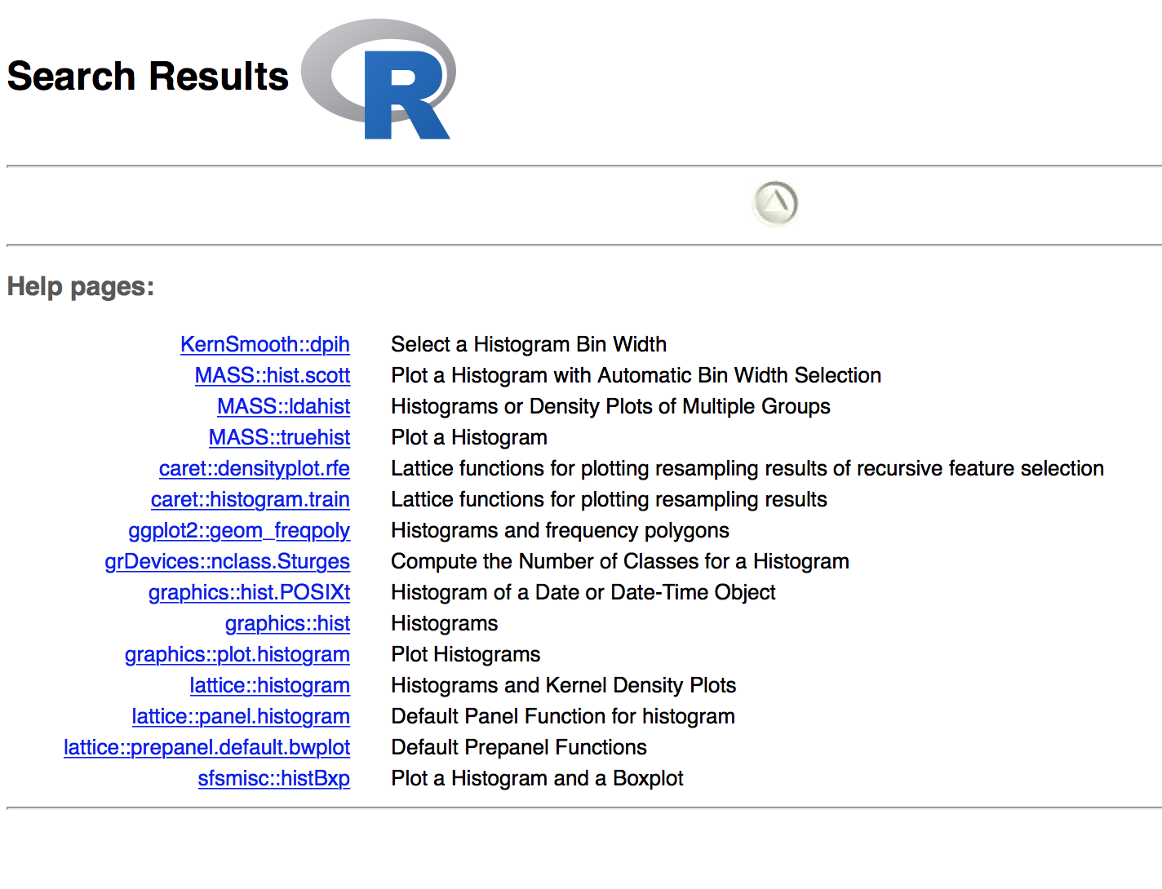
Getting help
If you are looking for something more general, or you do not know the name of the exact function. You may use the help.search() function.
For example, typing help.search("histogram") will give you
Notes:
If not, Google and Programming forums are always your best friends

Slide 44
End of Segment
Let’s take a break

